Slide 1
TITLE: AI AND CHATBOTS IN THE RETAIL INDUSTRY
Present To Our Expert: Anil Yerra Sir
Guided By our L2 Faculty Mohammad Tahir Mirji
Team Members:
Tanushri
Khyti
Priyanka
Laxmi
latha

Slide 2
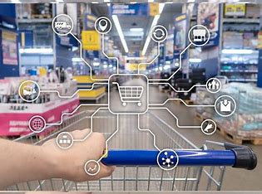
1. Introduction to AI in Retail:
- Brief overview of artificial intelligence (AI) and its applications in various industries.
- Importance of AI in the retail sector for improving customer experience and operational efficiency.

Slide 3
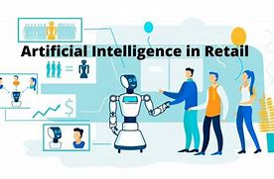
2. Benefits of AI in Retail:
- Personalized Customer Experience: AI-driven recommendation engines and tailored product suggestions based on customer preferences.
- Enhanced Customer Service: Chabot's and virtual assistants for quick and accurate customer support, available 24/7.
- Inventory Management: AI algorithms for demand forecasting, optimizing inventory levels, and reducing stock outs.
- Price Optimization: AI-powered pricing strategies based on market trends, competitor analysis, and customer behaviour.

Slide 4
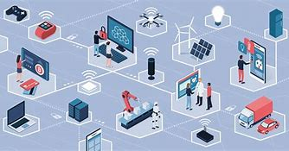
3. AI Applications in Retail:
a) Chabot's and Virtual Assistants:
- Role of Chabot's in providing instant responses to customer queries and guiding
them through the purchasing process.
- Use cases, such as order tracking, product recommendations, and resolving common customer issues.
b) Personalized Recommendations:
- AI-driven recommendation systems for suggesting relevant products to customers based on their browsing and purchase history.
- Examples of successful implementations and their impact on customer engagement and sales.
c) Visual Search and Augmented Reality (AR):
- AI-powered visual search tools enabling customers to find products using images.
- Integration of AR technology for virtual try-on experiences, allowing customers to visualize products before purchasing.
d) Supply Chain Optimization:
- AI algorithms for demand forecasting, improving logistics and transportation efficiency, and reducing costs.
- Real-time inventory tracking and predictive maintenance to ensure seamless operations.

Slide 5


4. Challenges and Considerations:
- Data Privacy and Security: Addressing concerns related to customer data protection and complying with relevant regulations.
- Ethical Use of AI: Ensuring transparency and fairness in AI algorithms to avoid bias and discrimination.
- Integration and Adoption: Overcoming implementation challenges and integrating AI systems with existing retail infrastructure.

Slide 6

5. Future Outlook:
- Emerging trends in AI for retail, such as voice-activated shopping, smart shelves, and personalized in-store experiences.
- Importance of ongoing research and development to further enhance AI capabilities in the retail industry.

Slide 7
6. Conclusion:
- Recap of the benefits of AI in the retail industry.
- Encouragement to embrace AI technologies to stay competitive and meet evolving customer expectations.

Slide 8
THANK YOU

